Slide 1
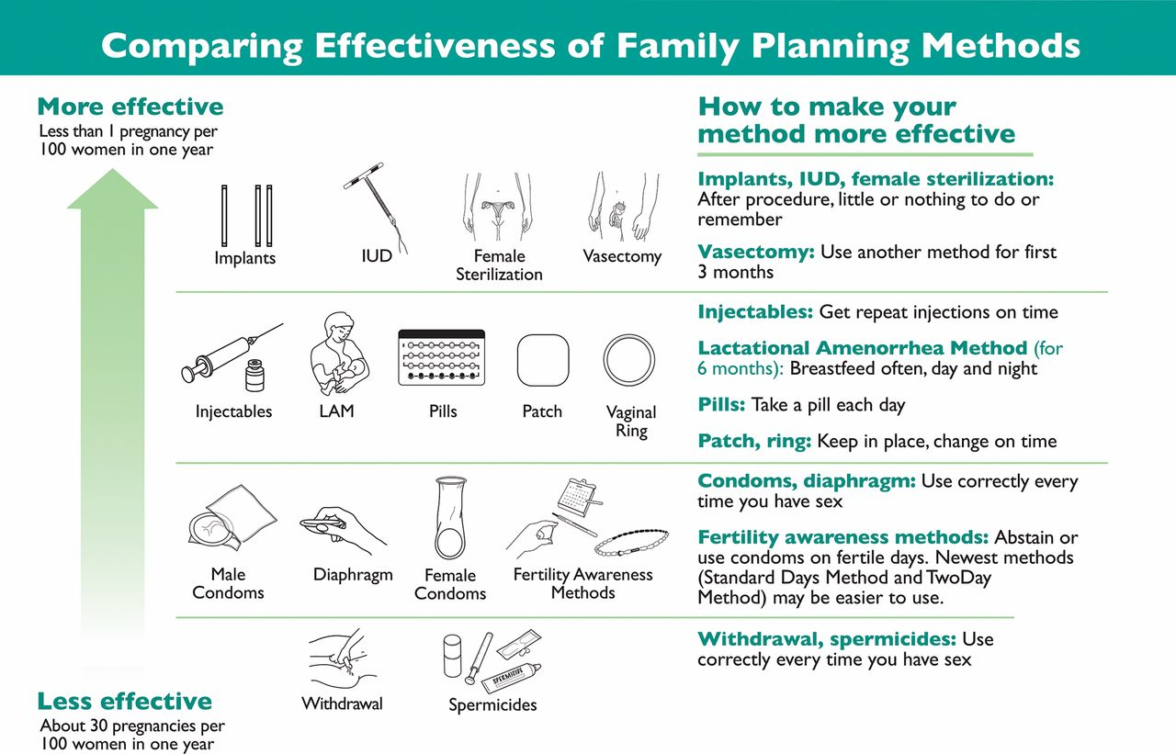

World Health Organization Model of Tiered Contraceptive EffectivenessSource: Steiner et al.,17 Trussell,18 and WHO.19.
John Stanback et al. Glob Health Sci Pract 2015;3:352-357
© 2017 Creative Commons Attribution 4.0 International License
Notes:
World Health Organization Model of Tiered Contraceptive EffectivenessSource: Steiner et al.,¹⁷ Trussell,¹⁸ and WHO.¹⁹

